Slide 1
Introduction
Concepts in Focus
Like operator
Wildcards in like :
Percentage sign
Underscore sign
Table
Examples

Slide 2
LIKE Operator
The LIKE operator is one of the SQL logical operators .
The LIKE operator is used in a WHERE clause to search for a specified pattern in a coloumn .
The LIKE operator returns true if a value matches a pattern or false otherwise .
The LIKE operator tests whether an expression matches the pattern .

Slide 3
Wildcards in LIKE
The percent sign (%) represents zero, one, or multiple characters .
The underscore sign (_) represents one, single character .

Slide 4
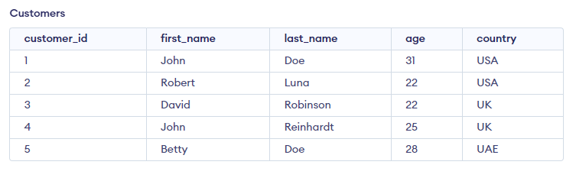
TABLE

Slide 5
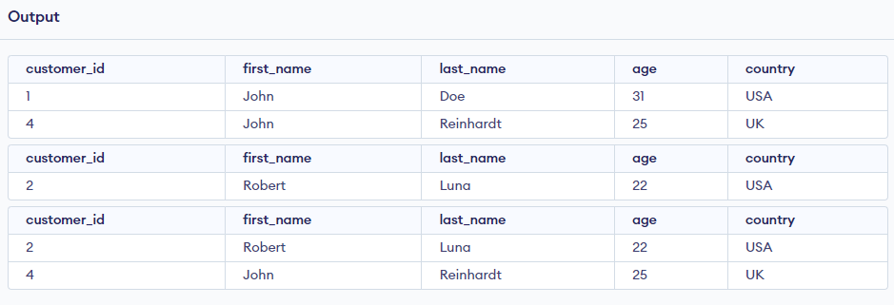
Examples
select * from Customers
where first_name like 'j%';
select * from Customers
where first_name like '%t';
select * from Customers
where last_name like '%a%';

Slide 6
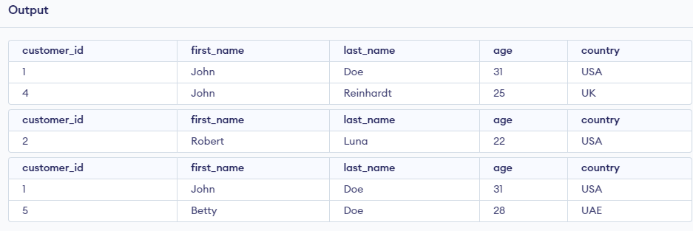
select * from Customers
where first_name like '_o__';
select * from Customers
where last_name like 'l___';
select * from Customers
where last_name like '__e'

Slide 7
THANK YOU

